Slide 1
Topic 14 Buffer Overflows
ST251Z Ethical Hacking and Defences

Slide 2
What is Buffer Overflow?
Buffer overflow accounts for a significant amount of exploits
Consequences can be dire
Occurs in programs that do not enforce bounds checking on arrays
Provide the application with more data than it can hold

Slide 3
What is Buffer Overflow?
void main() {
char buffer[5];
strcpy(buffer,
"abcdefghijklmnopqrstuvwxyz");
return;
}

Slide 4
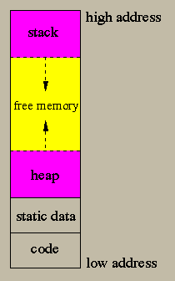


Memory Structure
Typically organised into 3 areas:
Code Segment
Stack Segment
Heap Segment
Heap and stack are dynamic

Slide 5
Memory Structure
Buffer overflow can occur in:
Stack
Memory in stack is allocated for functions
Stores local variables and return pointers
Heap
Memory in the heap is for dynamically allocated memory
Eg
int *number;
number = new int;

Slide 6
Stack Overflows
Most exploited class of buffer overflows
Concept:
When a function is called, the program will store the return address in the stack
Attacker uses buffer overflow to overwrite parts of the memory with his own code
Attacker also uses the buffer overflow to overwrite the return address in the stack to point to his code
Program will now run the attacker’s code

Slide 7
Stack usage (LIFO)
Stacks are based on a Last-In-First-Out (LIFO) concept
Data is “pushed” onto the top of the stack
D
“D” is pushed into stack
Top of Stack
C
B
A
Bottom of Stack

Slide 8
Stack usage (LIFO)
Data is “popped” from the top of the stack
“D” will be the first item to be popped from the stack
Top of Stack
The last item that goes into the stack will be the first item to go out
D
C
B
A
Base of Stack

Slide 9
Stack usage
When a program is run, the first function to run is often called the “main” or “entry point”
When a function is running, it stores its local variables in the stack.
The stack will grow and shrink as functions are called and returned

Slide 10
Stack usage
When a program is run, the Instruction Pointer (EIP or RIP) holds the address of the next instruction to be run
Simplified Example
void main {
printf(“step 1\n”);
printf(“step 2\n”);
printf(“step 3\n”);
}
After “step 2” is printed, the EIP or RIP will point to the next instruction “step3”

Slide 11
Stack usage
When a function or subroutine is called, the EIP or RIP will point to the function/subroutine
After function/subroutine completes running, the program must know where to return to
function callA() {
printf(“in callA\n”);
}
void main {
printf(“step 1\n”);
callA();
printf(“step 2\n”);
}
Before jumping to callA, the address of instruction “step 2” is stored somewhere so that the program will know where to return to

Slide 12
Stack usage
The stack is used to hold the return address whenever a function/subroutine is encountered
Simplified Example
Base of Stack
10 function callA() {
11 printf(“in callA\n”);
12 }
13 void main() {
14 printf(“step 1\n”);
15 callA();
16 printf(“step 2\n”);
17 }
Data
Data
Top
Address : 16
Before jumping to callA, the address of the next instruction is pushed to stack

Slide 13
Stack usage
When the function callA has completed, the return address will be popped from the stack, and execution continued
Base of Stack
Simplified Example
A
10 function callA() {
11 printf(“in callA\n”);
12 }
13 void main() {
14 printf(“step 1\n”);
15 callA();
16 printf(“step 2\n”);
17 }
B
Address : 16
Top
Address of the next instruction is popped from stack

Slide 14
Stack Problem
The problem arise if the hacker manages to overwrite the return address in the stack with an address to his own malicious code
Simplified Example
10 function callA() {
11 printf(“in callA\n”);
12 }
13 void main() {
14 printf(“step 1\n”);
15 callA();
16 printf(“step 2\n”);
17 }
18 // hacker’s code
Base of Stack
A
B
Address : 18
Top

Slide 15
Stack Overflow
Overwriting the return address in the stack can be done through stack overflow
The hacker overflows a local variable in the stack until he reaches the return address
Base of Stack
Return address
Hacker overflows the variable until it overwrites the return address
Variable

Slide 16
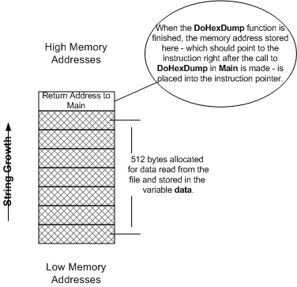
Data Stack
void DoHexDump(FILE* file)
{
int len;
unsigned char data[512];
FILE* fp = file;
fseek(fp, 0, SEEK_END);
len = ftell(fp);
fseek(fp, 0, SEEK_SET);
//Possible Overflow!
fread(data, 1, len, fp);
fclose(fp);
DumpHex(data, len);
}

Slide 17
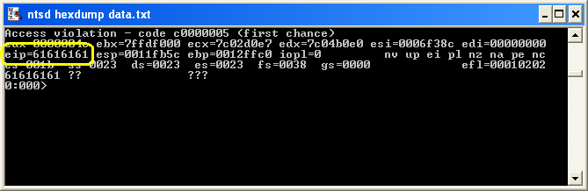
Stack Overflow
In this example, pushing 516 “a” characters will overwrite the return address
“a” = ASCII value of 61

Slide 18
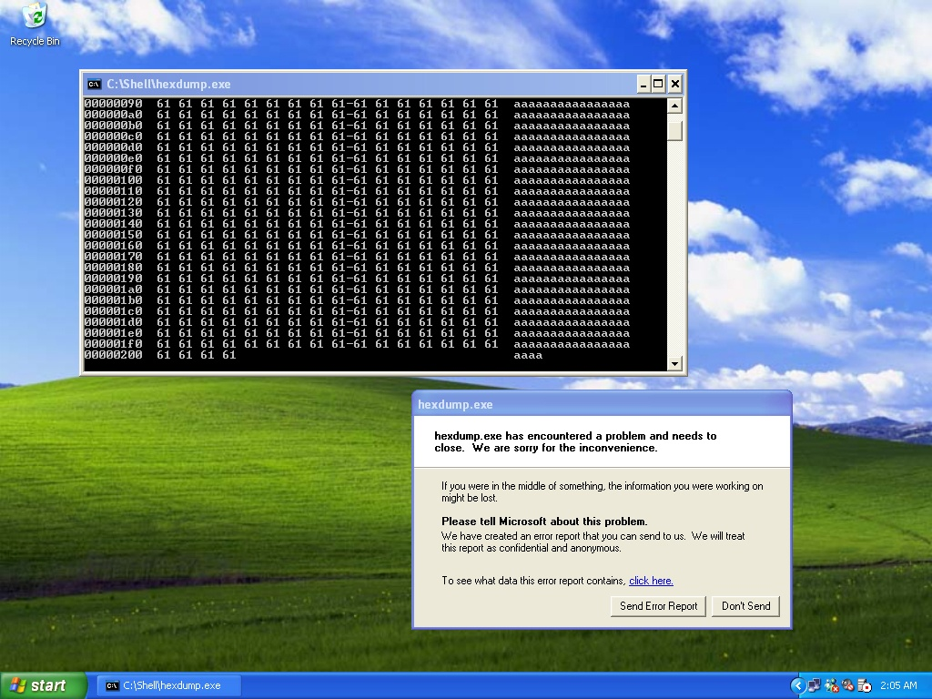

Slide 19
Exploiting Stack Overflow
Strategy: change the return pointer such that it points to other user-supplied data on the stack
Could be a shellcode/op-code entered by the attacker
Could be a loaded function already in stack

Slide 20
Shell Code Examples
68 78 fb 11 00 FF 15 30 20 40 00 launches notepad.exe in Windows using an already loaded library called Msvcr70.Sytem
eb 2a 5e 89 76 08 c6 46 07 00 c7 46 0c 00 00 00 00 b8 0b 00 00 00 89 f3 8d 4e 08 8d 56 0c cd 80 b8 01 00 00 00 bb 00 00 00 00 cd 80 e8 d1 ff ff ff 2f 62 69 6e 2f 73 68 00 89 ec 5d c3 launches a shell in Linux on Intel

Slide 21
Stack Frames
When a function is called, some data is pushed to the stack
This data is called a Stack Frame
Function arguments (pushed in reverse order)
Return address (current EIP or RIP value)
Base Pointer : EBP or RBP (current EBP or RBP value)
Memory space needed for local variables

Slide 22
Stack Frames
In a typical program, multiple nested functions may be called
With each function call, the data associated with each function (return address, local variables) are pushed onto the stack – the stack frame
The RBP (or EBP) and RSP (or ESP) are updated with each function call
Main function
Main function calls Function A
Function A
Function A calls Function B
Function B

Slide 23
Stack Frames
Base of Stack
Main function
1. Program starts in main function
Stack frame for Main function
2. Stack frame for main function pushed onto stack
Stack frame for Function A
Function A
3. Function A is called
4. Stack frame for Function A pushed onto stack
5. Function A completes. Returns to main function
6. Stack frame for Function A popped out

Slide 24
Understand Stack Frame
Higher Address
EBP
ESP
argument
foobar(arg1, arg2){
char foo[8];
gets(foo);
}
main(){
foobar(arg1, arg2);
printf(“bye”);
}
return
Stack
Old EBP
Local variables
Lower Address

Slide 25
Understand Stack Frame
EBP (or RBP) points to base of stack
ESP (or RSP) points to top of stack
When calling the foobar function
Any arguments for function foobar are pushed to stack. ESP is moved
The address of next instruction (printf) is pushed to stack. This is the return address. ESP is moved
Current value in EBP is saved to stack. ESP moved. EBP moved to top of stack to point to “new base”
Any local variables in foobar are pushed to stack. ESP is moved.

Slide 26
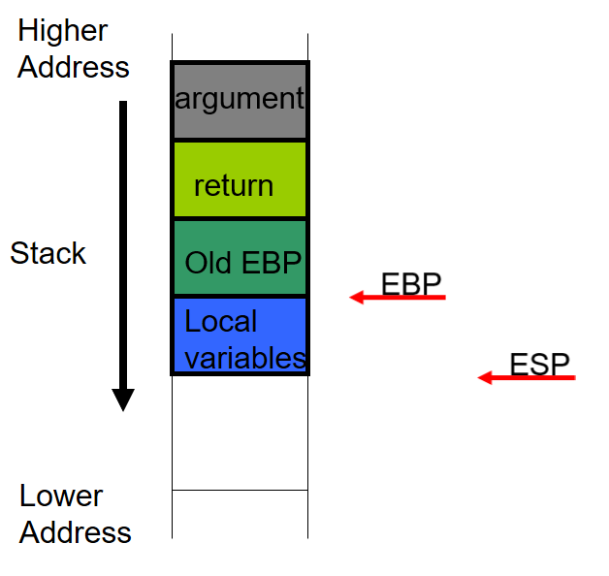
Understand Stack Frame
Local variables and function arguments are referenced from the EBP
Function arguments can be referenced by adding to the EBP
Local variables can be referenced by subtracting from the EBP

Slide 27
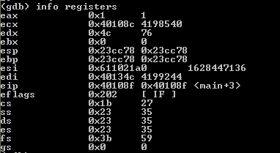
Understand Stack Frames
Higher Address
getInput(){
char foo[8];
gets(foo);
puts(foo);
}
main(){
getInput();
}
EBP
ESP
0x23cc78
return
Old EBP
Local variables
Lower Address
Stack

Slide 28
Exploits
#include <stdio.h>
NeverExecute()
{
printf("We'll never reach here\n"); exit(0);
}
GetInput()
{
char buffer[8];
gets(buffer);
puts(buffer);
}
main()
{
GetInput();
}
Objective : to use bufferoverflow to execute function NeverExecute()
Need to know address of the function NeverExecute
A debugger can help – we’ll learn more in next topic

Slide 29
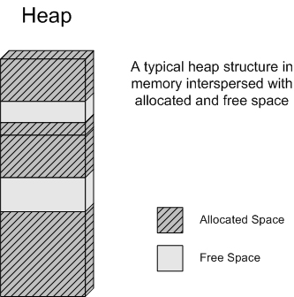
Heap Overflows
Storage is dynamically allocated and freed during program execution
Interspersed blocks of allocated and free memory

Slide 30
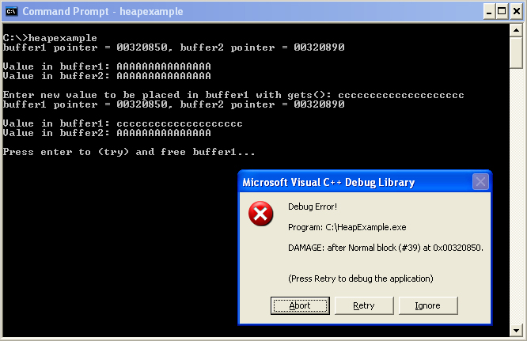
Heap Overflows
When overflow occurs, memory blocks are corrupted and results are unpredictable

Slide 31
Other exploits
Can be used to update files not allowed to
Eg. Code Red worm affects IIS5
Deface web sites running IIS5
Attempt to launch DoS against White House
Escalate privilege over a system

Slide 32
Finding this vulnerability
White box testing technique and tools
Access to codes
Look for unsafe function like strcpy, gets, etc
Automated tools – RATS, ITS4, FlawFinder
May generate false positive though

Slide 33
Finding this vulnerability
Black box testing technique
No access to codes
Look at data supplied by untrusted user
User interface, data files, API, registry, etc
Simple technique: just apply very long string

Slide 34
Fixing this vulnerability
Avoid unsafe functions like strcpy and use safer alternatives
Take particular care when copying, moving, storing data
Do not trust inputs
Check size of data

Slide 35
Practical Exercises
Try the practical exercises for buffer overflow

